Slide 1
Tutorial

Slide 2
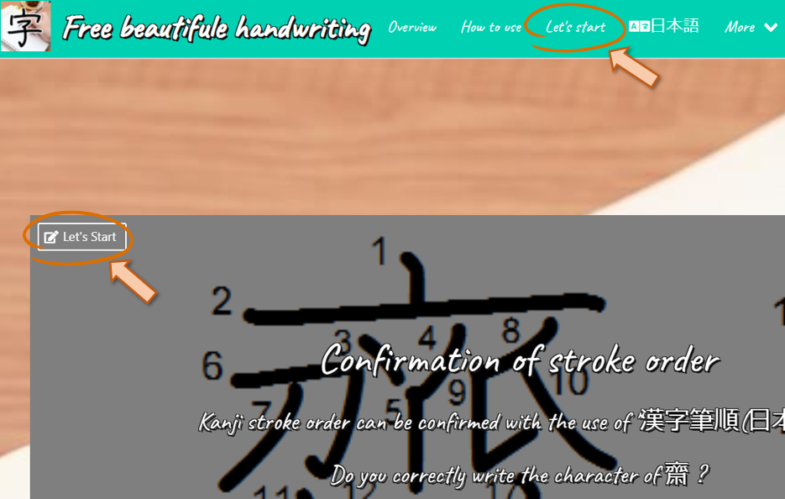
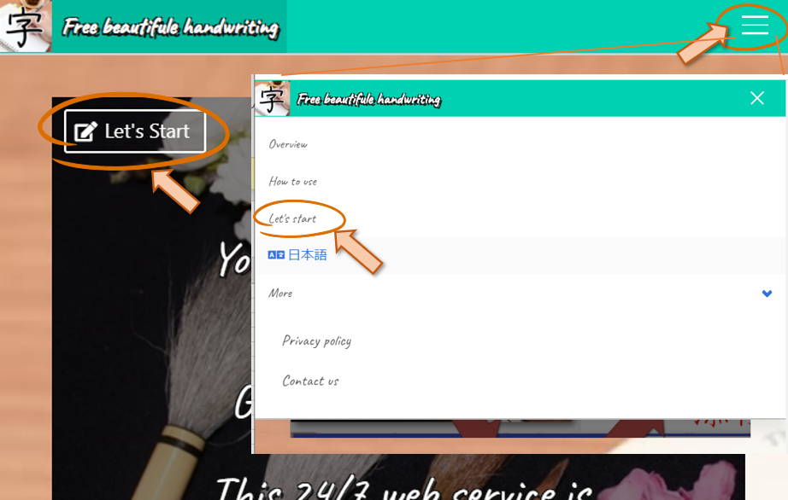
Step1. Let’s start.
https://www.bimoji.net/
・Click the “Let’s start”.
Desktop
Mobile

Slide 3
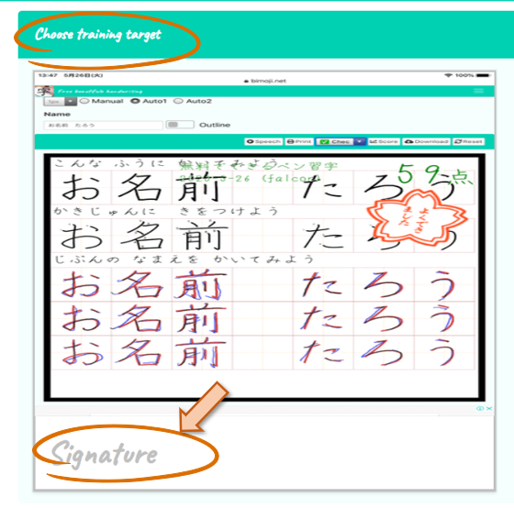
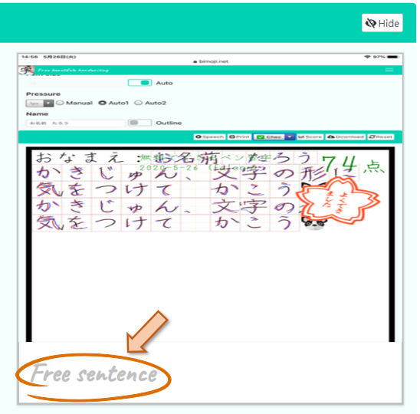
Step2. Choose training target.
Signature → Case:A.
Free sentence → Case:B.

Slide 4
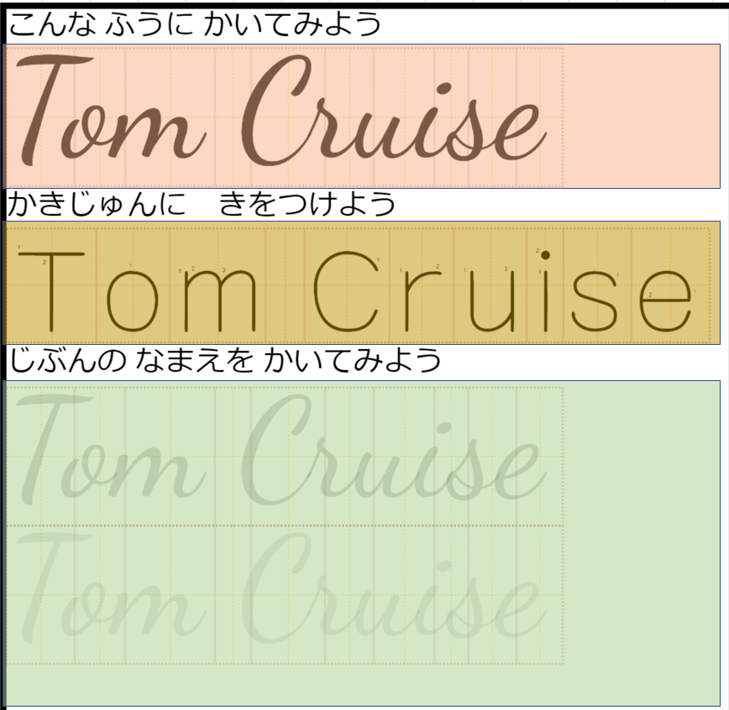
Case:A. Training your signature.
Layout
・Example
・Stroke orders
・Practice

Slide 5
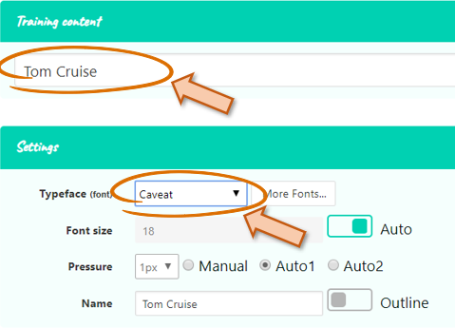
Step:A.1. Set the content
(Training your signature)
・Input your name.
・Select Typeface(font).

Slide 6
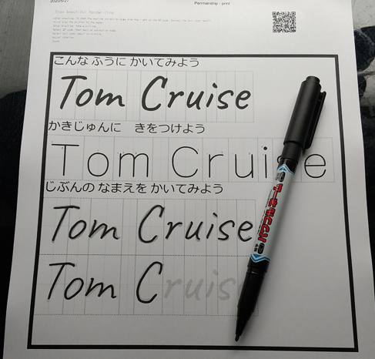
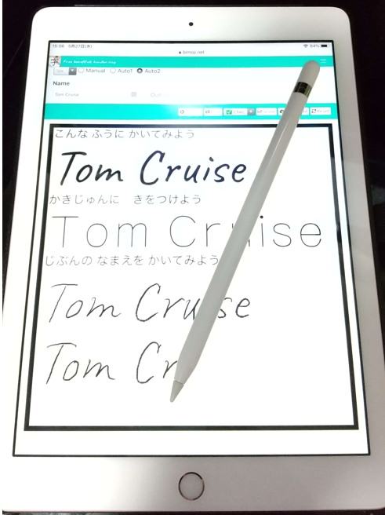
Step:A.2. Choose environment
(Training your signature)
On the PAPER → A.2.1.
On the TABLET → A.2.2.

Slide 7
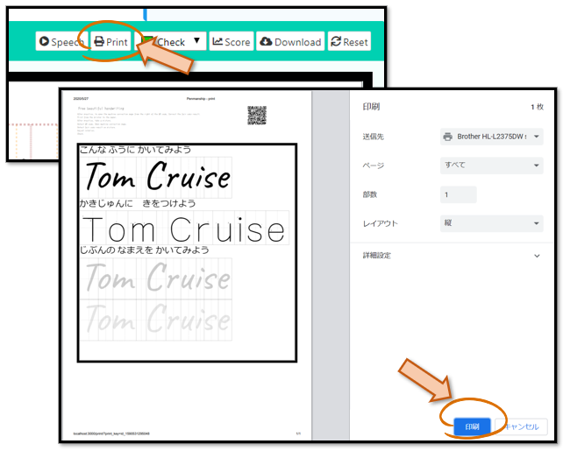
Step:A.2.1. On the PAPER - 1
(Training your signature)
・Click the “Print”.
・Click the “Print/印刷” at the Print Dialog.

Slide 8
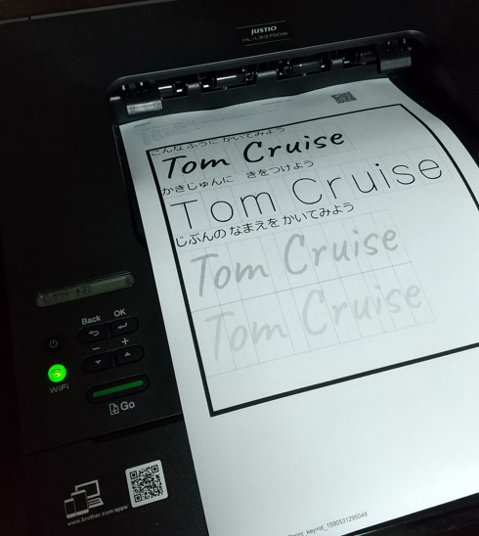
Step:A.2.1. On the PAPER - 2
(Training your signature)
・Print from the Printer.

Slide 9
Step:A.2.1. On the PAPER - 3
(Training your signature)
・Practice your signature on the paper.

Slide 10
Step:A.2.1. On the PAPER - 4
(Training your signature)
・Open “Check” dropdown.
・Select “Correct your fair copy with an image file”.

Slide 11
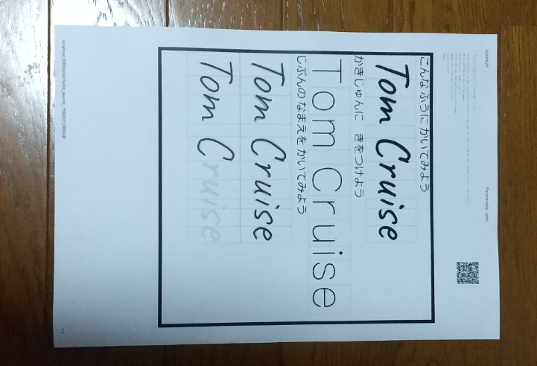
Step:A.2.1. On the PAPER - 5
(Training your signature)
・Take a picture.

Slide 12
Step:A.2.1. On the PAPER - 6
(Training your signature)
・Select the image(picture) file.

Slide 13
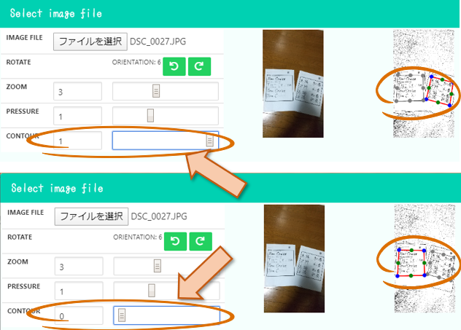
Step:A.2.1. On the PAPER - 7
(Training your signature)
・Choose another contour if you need.

Slide 14
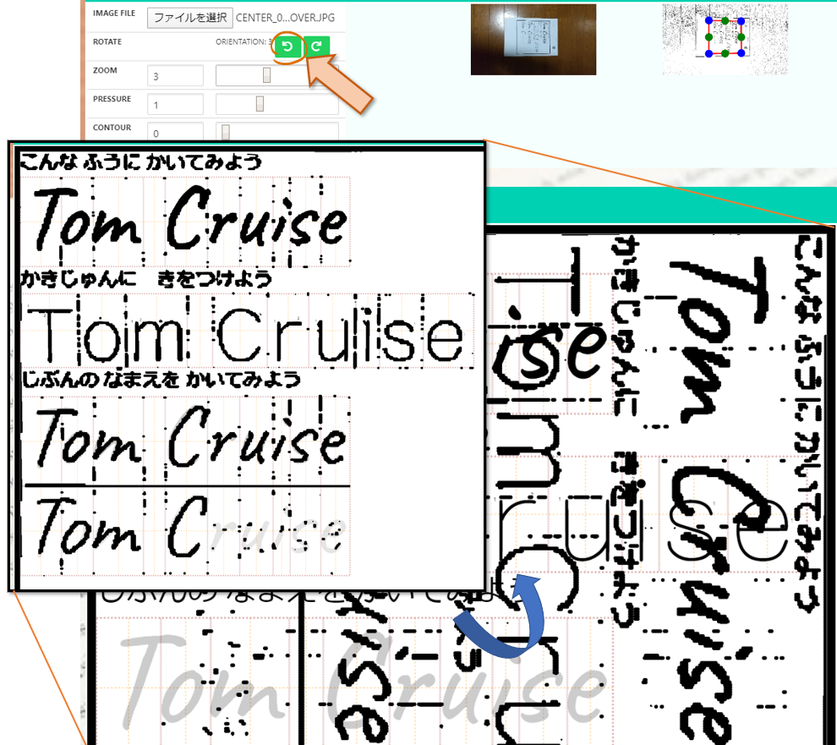
Step:A.2.1. On the PAPER - 8
(Training your signature)
・Rotate image if you need.

Slide 15
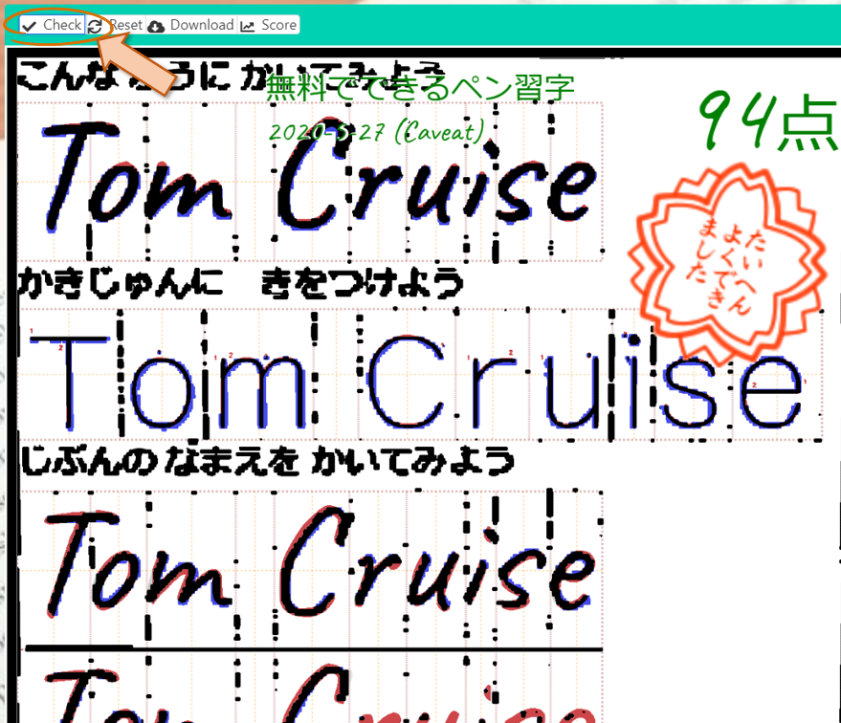
Step:A.2.1. On the PAPER - 9
(Training your signature)
・Check.

Slide 16
Step:A.2.2. On the TABLET - 1
(Training your signature)
・Practice your signature on the tablet.

Slide 17
Step:A.2.2. On the TABLET - 2
(Training your signature)
・Open “Check” dropdown.
・Select “Correct your traced result on this touch panel”.

Slide 18
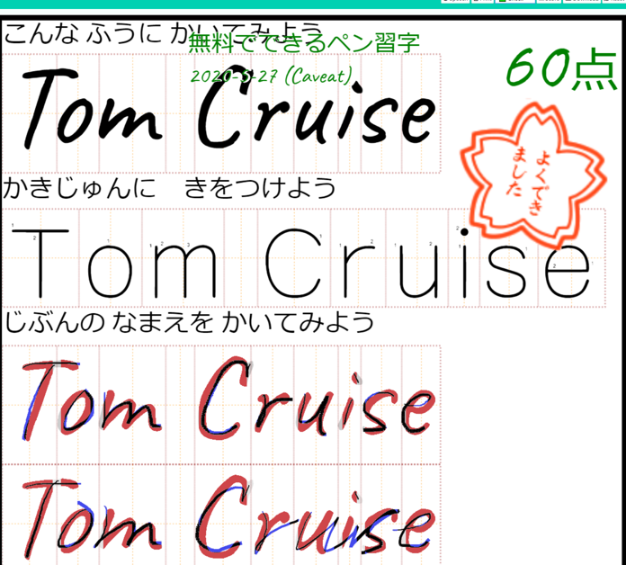
Step:A.2.2. On the TABLET - 3
(Training your signature)
・Check the result.

Slide 19
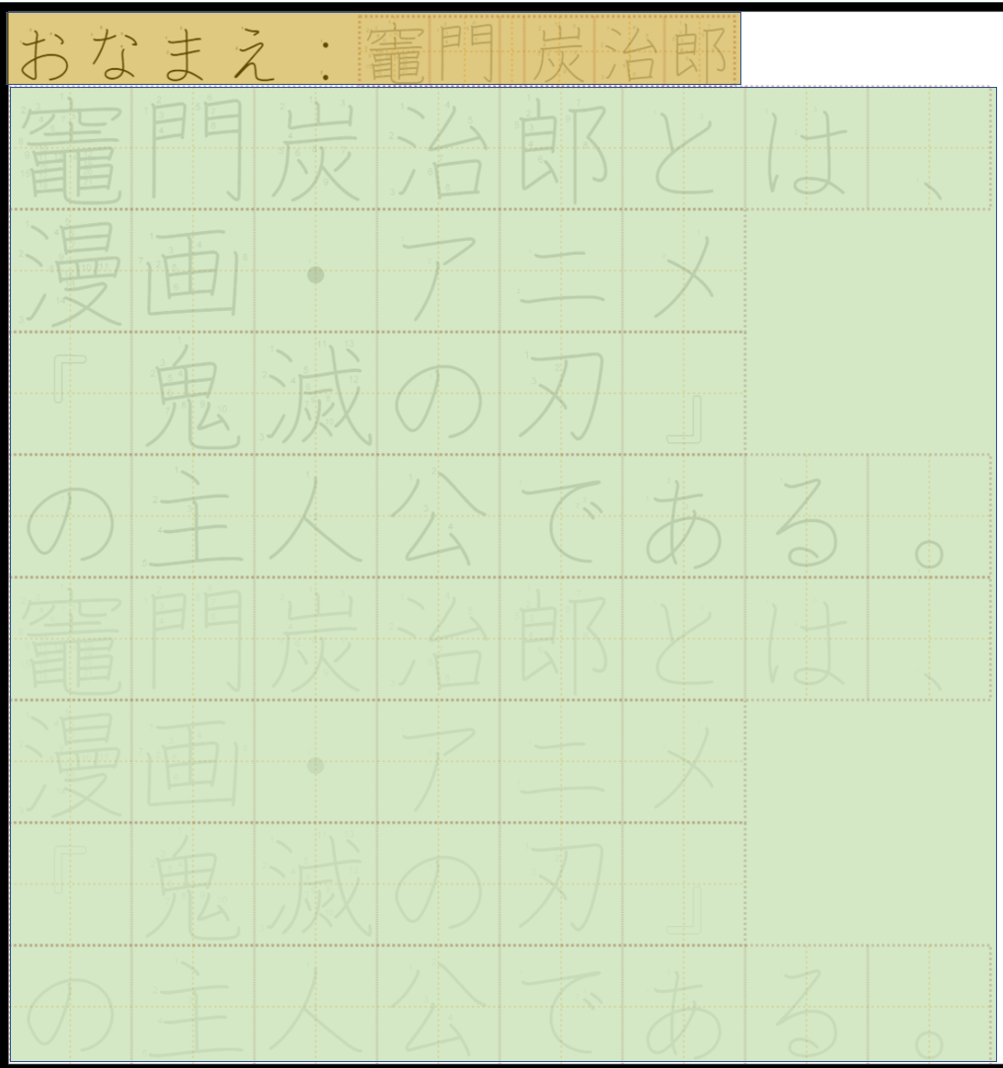
Case:B. Training free sentence.
Layout
・Your name
・Practice

Slide 20
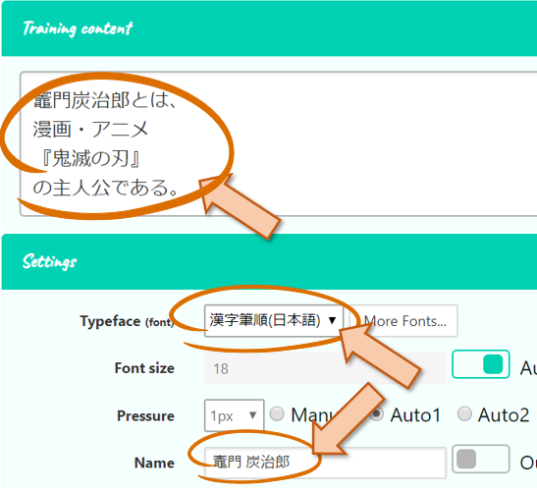
Step:B.1. Set the content
(Training free sentence)
・Input free sentence.
・Select Typeface(font).
・Input your name.

Slide 21
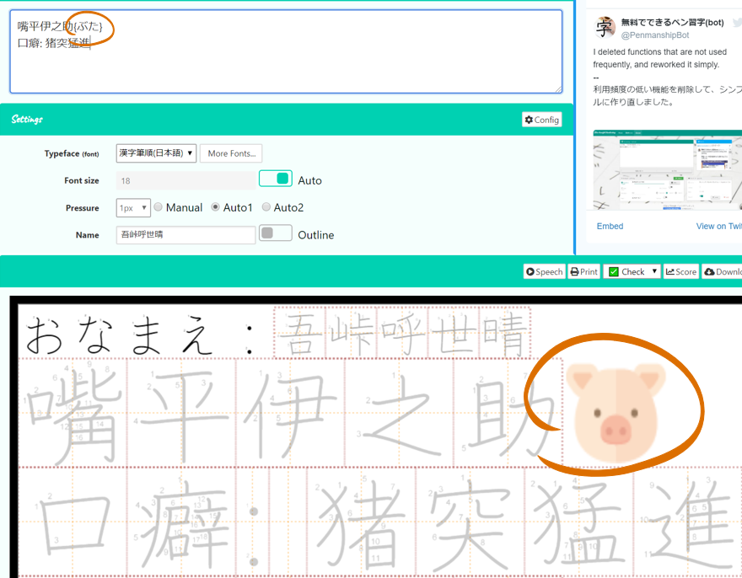
Step:B.2. Append Icons-1
(Training free sentence)
・You can put some icons.
Icon template: {name}
Example: {ぶた}

Slide 22
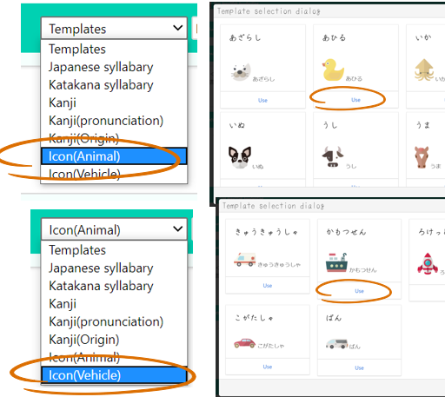
Step:B.2. Append Icons-2
(Training free sentence)
・You can choose a icon from dialog.
・Click “use” button.

Slide 23
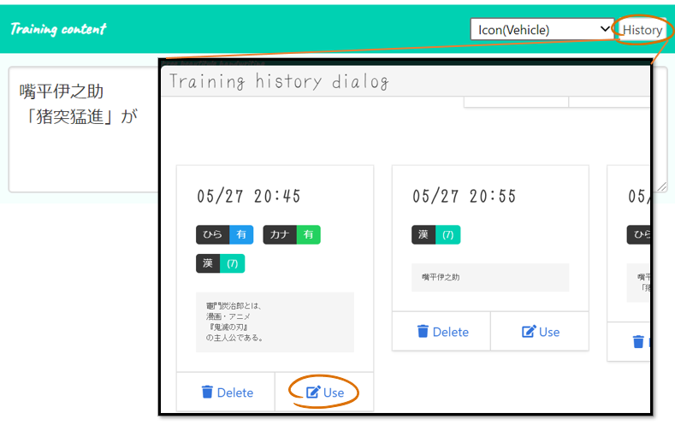
Step:B.3. History
(Training free sentence)
・You can also set sentence from the history dialog.

Slide 24
Step:B.4. History
(Training free sentence)
・You can also set sentence from the history dialog.

Slide 25
Step:B.5. Practice and Correct
(Training free sentence)
・Same as “Training Signature”

